Slide 1
Resumes and Cover Letters
Bethel School of Technology Career Services

Slide 2
Workshop Overview
Resumes
ATS vs. Non-ATS Resumes
Proper Formatting and Structure
S.M.A.R.T. Method
Cover Letters
Resources

Slide 3
Definitions
Resume - a succinct document, laying out your skills, education, abilities, and experience. It should highlight your strongest and most relevant assets that differentiates you from other candidates.
Cover Letter - accompanies the resume as an introduction to your resume. The purpose is to introduce yourself in a narrative (no longer than 1 page) to the company to show your interest in the company you’re applying for. Its purpose should be to motivate the reader to interview you. It should not sound needy. A cover letter should be individualized and written for each position you’re applying to. Although you’re wanting to “market” yourself, keep in mind the organization’s hiring needs as well.
CV - (curriculum vitae) is a brief summary of your experiences and abilities, but most used frequently in academic settings. A little different from a typical resume, you will include more credentials relevant to academia and research, such as publications, presentations, and references.

Slide 4
2 Types of Resumes
ATS (Applicant Tracking System) version, and a pretty version
99% of Fortune 500 companies use an ATS
On average 250+ applications per job posting. Companies use ATS to speed up hiring process and push most relevant resumes to the top of the stack
Even if a candidate is highly qualified for the job, if they don’t have the right keywords on their resume, they might not be found.
BUT 85-90% of jobs are gotten through personal connection
Make you complete your ATS version first and then you can worry about a Non-ATS version of your resume

Slide 5
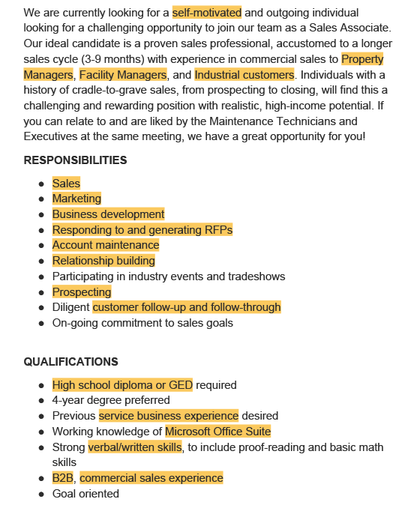
ATS Example
Notes:
Speed bump still

Slide 6
ATS Resume
https://docs.google.com/document/d/1D88iK-oZEwhWT4KwFHxW-SJOAHExmqcnQpJhOyujLTo/edit?usp=sharing
Check if your resume is ATS friendly!

Slide 7
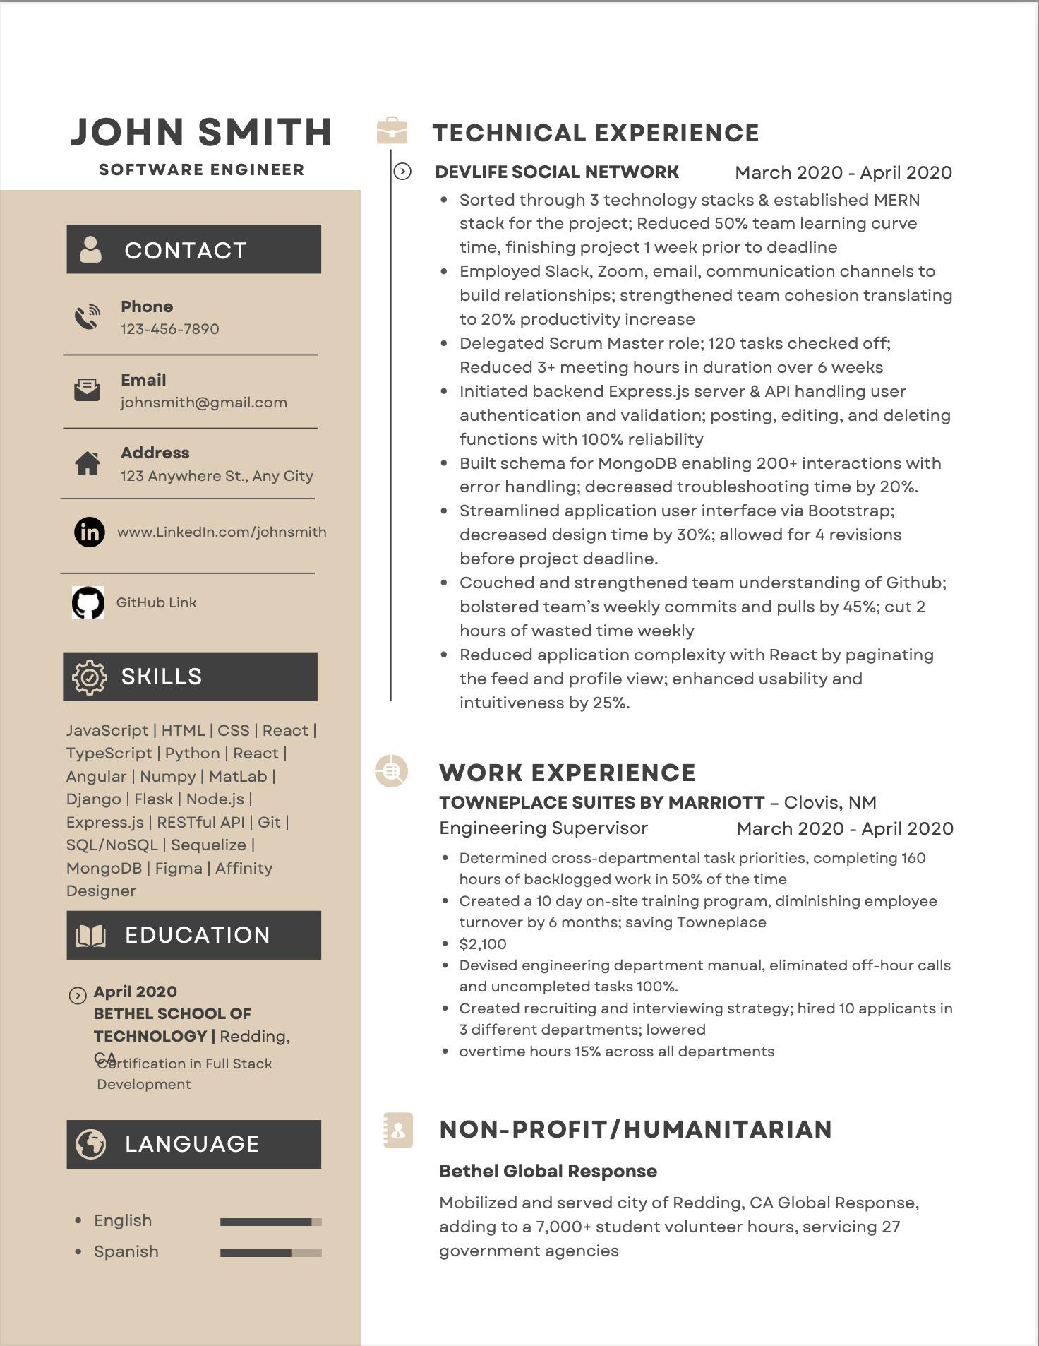
Non-ATS Resume
(Pretty Version)

Slide 8
Template Resources
Doc/Word Templates
Google Drive> Google Docs> Template> Resumes
Microsoft Word> New> Template> Resumes
Harvard Resumes
Yale Office of Career Strategy
Cultivated Culture (Resume Builder)
Novo Resume
Enhancv
KickResume
Canva (non-ATS version only)

Slide 9
SPECIFIC
MEASURABLE
APPLICABLE/ACCURATE
RELEVANT
TIME-BOUND
Don’t just list your duties. What was the Result?
Include as many “quantifiables” within the EXPERIENCE categories of your resume (#s, %s, $$$) to explain cost/budget, time, scope of work, etc.
Bullet Point Framework: Accomplished (Power verb) as measured by Y by doing Z
Examples:
Streamlined workflow process to resolve communication delivery and solutions up by 30 days, reducing the time by 50%
Directly influence the ROI of $4,000 investment of software to a $20,000 profit gain in financial solutions
Achieved 97% average customer satisfaction rating, surpassing team goal by 12%.
Which candidate would you choose?
Candidate A: "Provided great customer service and regularly exceeded customer service score goals across multiple customers."
Candidate B: "Exceeded customer service score goal of 90% or above for the past 6 quarters and consistently ranked in the top 5% out of 500 team members servicing Fortune 500 accounts."

Slide 10
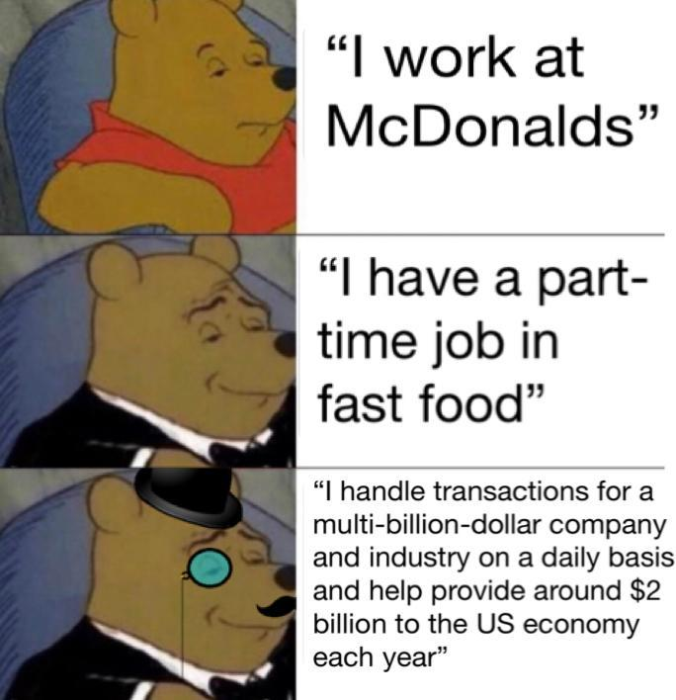
Get Creative

Slide 11
Cover Letters
Google Doc and Microsoft Word have templates with correct formatting
Send Cover Letter in non-editable PDF form
Personalize to the organization you’re applying to
Introduce yourself in a narrative to the company to show your interest in the company you’re applying for. Its purpose should be to motivate the reader to interview you
“Should I submit a cover letter if it’s optional?”
1 page, 3 paragraphs: Introduction (WHY), Body (WHAT), and Closing (HOW)

Slide 12
Cover Letter Template
Introduction (WHY)
Identify the position for which you are applying, career objectives, how you heard about the position, and why you’re interested
Include Why (somewhere within the letter):
Why are you interested in the organization?
Why they should be interested in you
Body (WHAT)
You can expound on the additional "why" here.
Through the body, write your understanding about the position you’re applying for and how your qualifications relate. You don’t need to repeat what’s on your resume but can expound on your skills, successes, and qualifications where you present that you’re a strong candidate. Show how you can contribute to the company.
Avoid overusing “I” especially more than twice in a paragraph.. Instead of saying, “I have enclosed a copy of my resume,” say, “You can find an enclosed copy of my resume,” or “Enclosed you will find a copy of my resume.”
Closing (HOW)
Write how and when you will contact them, to follow up and schedule an appointment
Sign your name at the end.

Slide 13
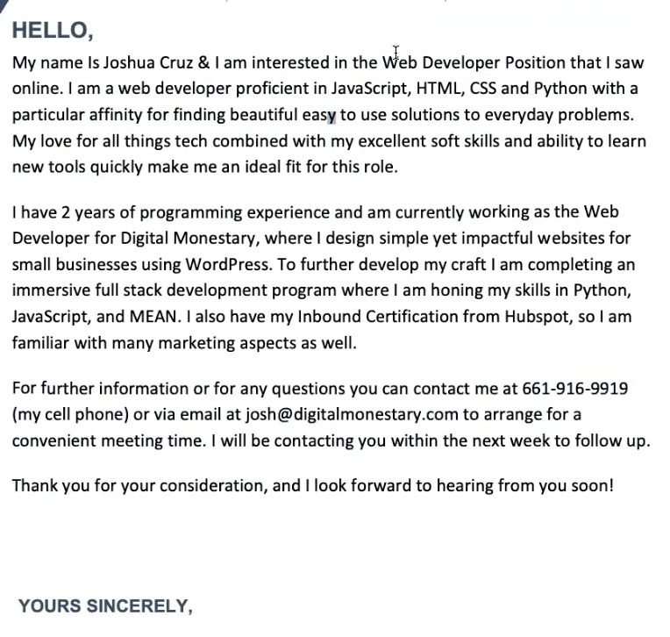
Cover Letter Example

Slide 14
More Resources
Complete Cover Letter Guide
How to Start a Cover Letter
How to Write an Amazing Cover Letter
List of Good Action Verbs
More Action Verbs!
Applicant Tracking Systems: A Guide for Job Seekers
What Happens to Resume Tables and Columns in an ATS?
3 Tips Most Recruiters Won’t Tell You About Writing Your Resume
VIDEO: How To Write A Cover Letter
VIDEO: How To Write a Resume with No Job Experience
VIDEO: 3 Biggest Resume Mistakes

